Slide 1
Putt-Putt Golf
IVE Semester Project
Jared Gregor
Spring 2020

Slide 2
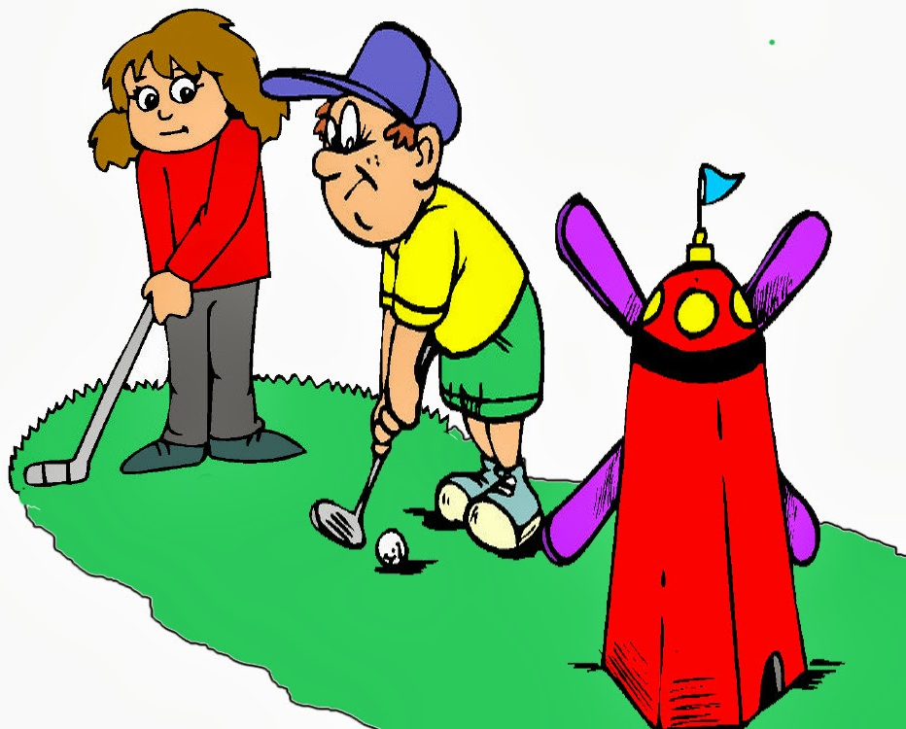
Why
Mini Golf?
Motivations
Game loved by many
Provokes understanding of geometry and physics to determine the best shot
Fun for people of all ages
http://clipart-library.com/clipart/1778609.htm

Slide 3
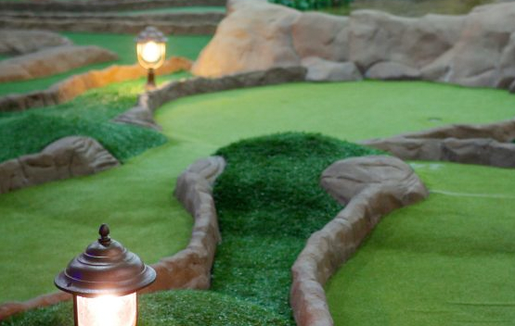
Why
Mini Golf?
Limitations
Walking around a small and usually rough terrain may be out of the question for some
People with disabilities
Older folks
Health concerns
Weather is a huge factor
https://www.minigolfcreations.com/how-to-build-mini-golf-course-business/

Slide 4
Virtual Putt-Putt Golf!

Slide 5
Equipment
Unity 2019.3.7f1
Generate Virtual Environment and Event System
Blender 2.82
Model the greens for 9 hole course
Head Mounted Display (Coming Soon…)
Play the game in Virtual Reality!

Slide 6
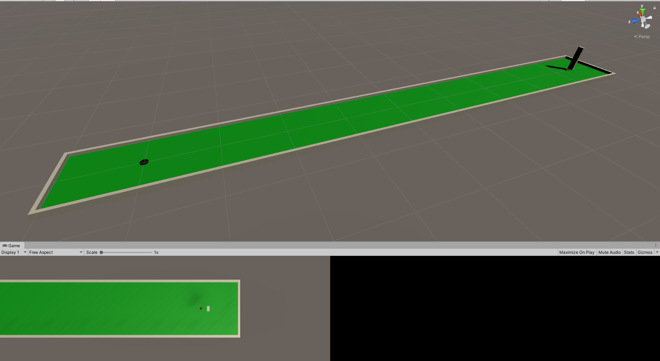
Start small and build up…
Get it working on a single hole course first!

Slide 7
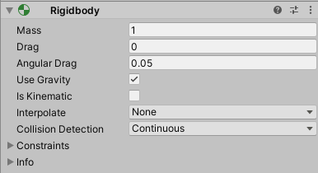
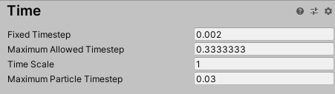
Ball interactions
Tick Rate (x10)
Continuous Collisions

Slide 8
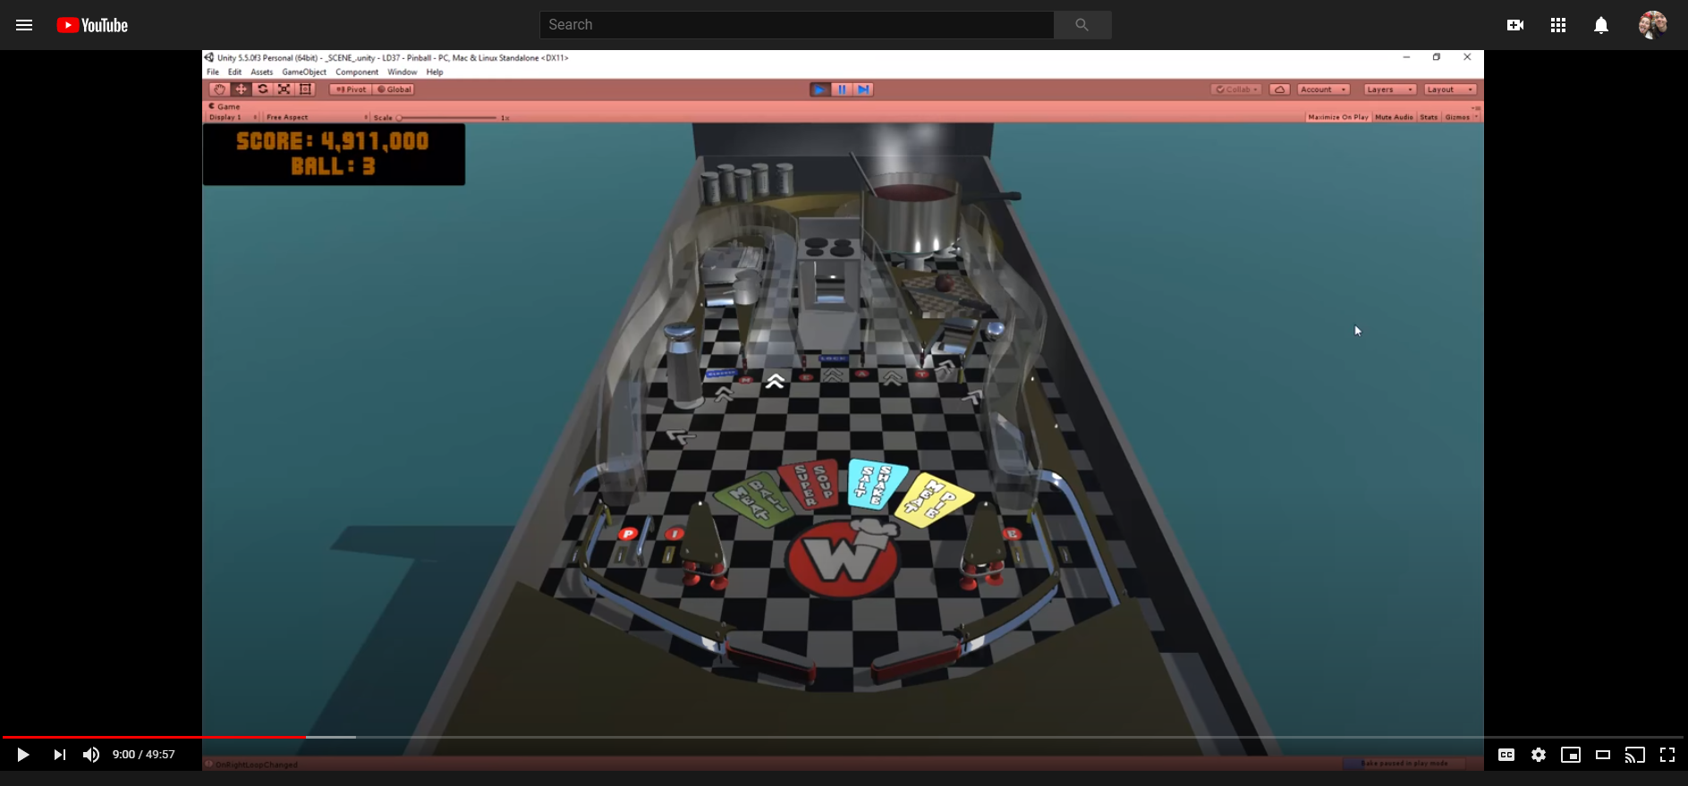
Ball interactions
Pinball Video!
Lot of similarities
Rolling ball
Objects moving to hit ball
Keeping score

Slide 9
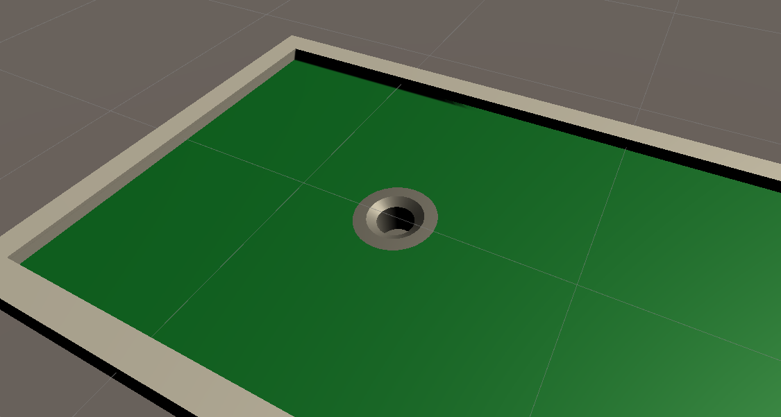
Better Hole
Fake hole tutorial in Unity without changing mesh

Slide 10
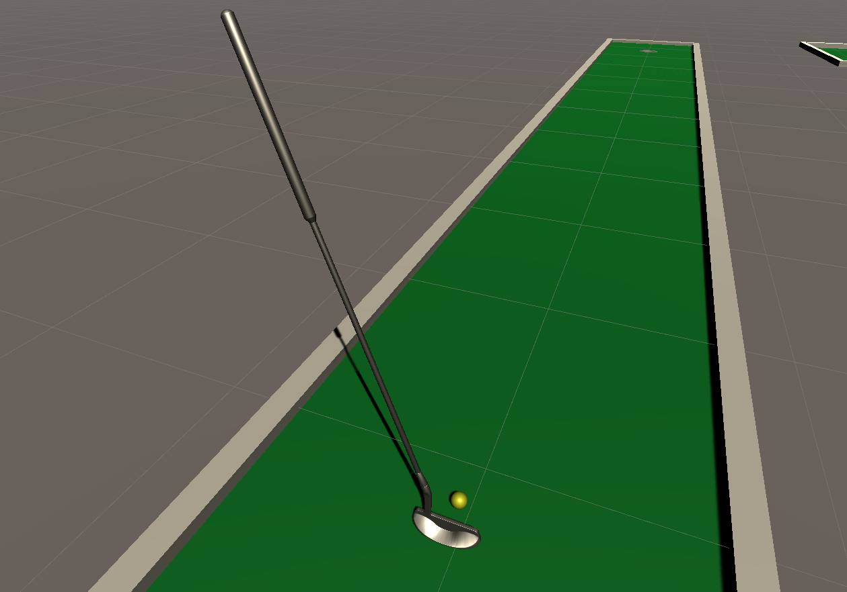
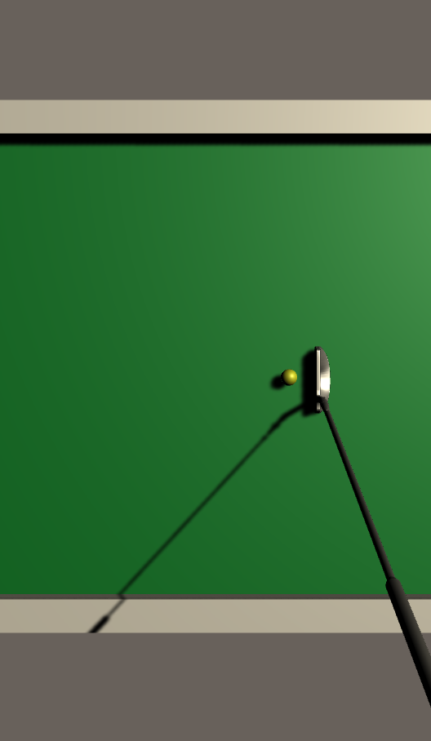
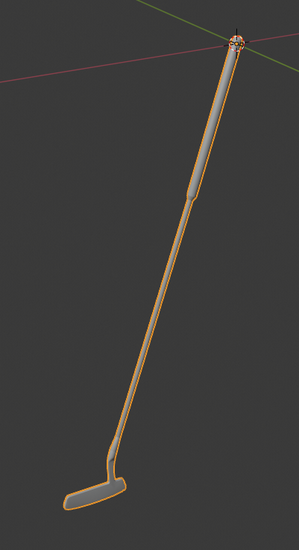
Better Club
Improved club model found online for free
Changed Origin to handle for realism

Slide 11
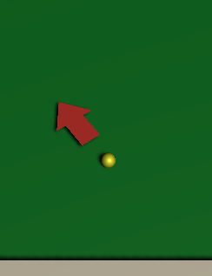
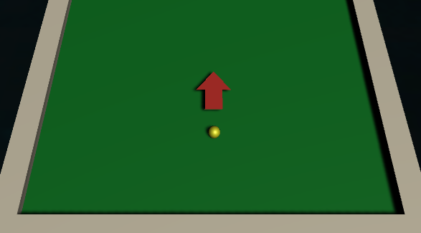
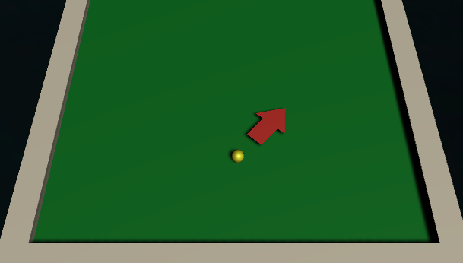
Game Mechanics
Choosing a putter angle
SPACE

Slide 12
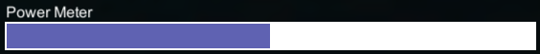
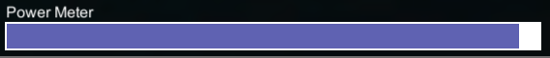
Game Mechanics
Choosing a putter power
SPACE

Slide 13
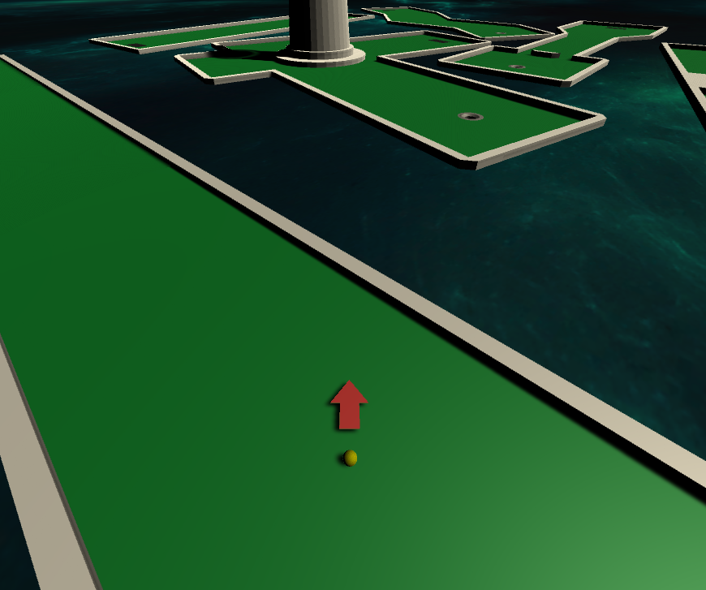
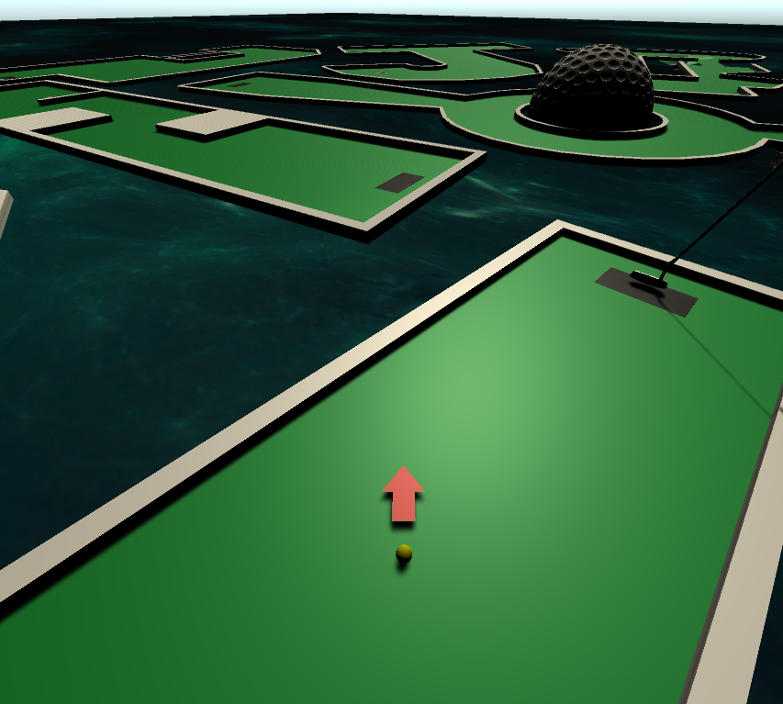
Game Mechanics
Viewing the course
Camera follows ball position and arrow rotation

Slide 14
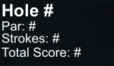
Game Mechanics
Keeping Score
What hole are we on?
Current Par?
Current strokes taken?
Total strokes taken?

Slide 15
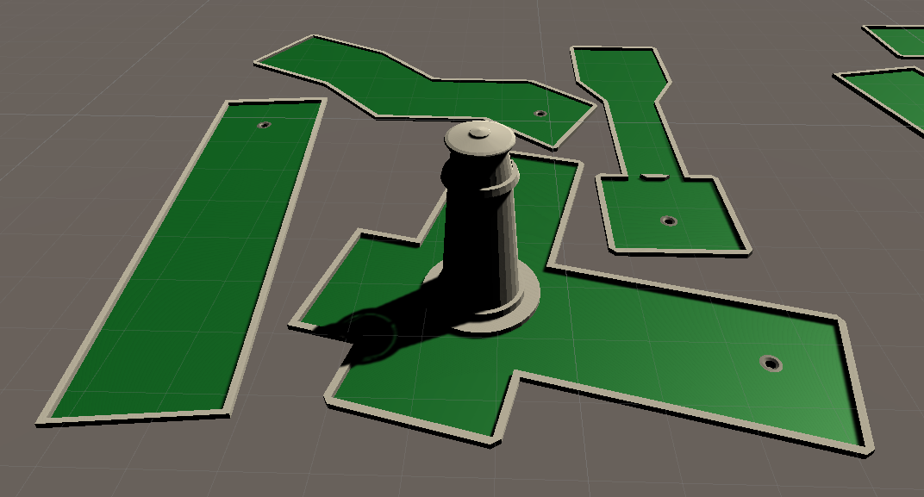
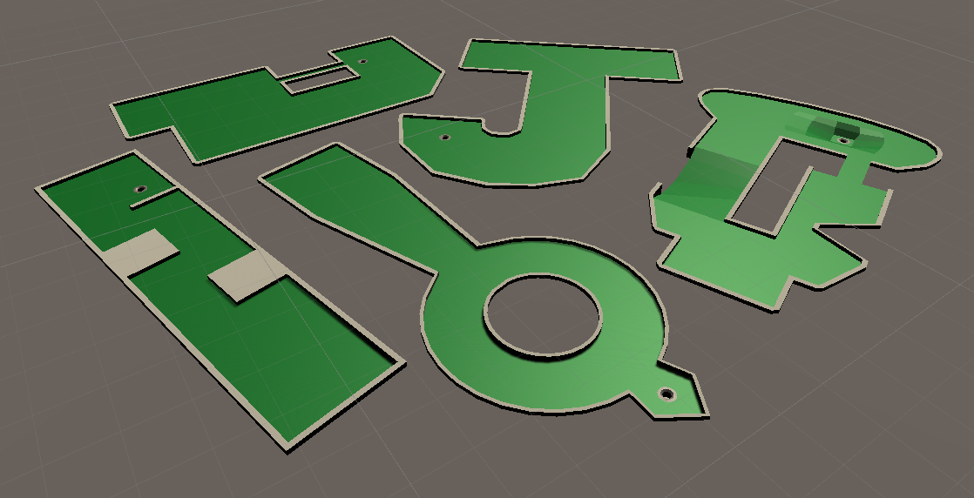
Expanding to 9 holes
Build the green in Blender
Import to unity and add materials
Array of levels for easy importing

Slide 16
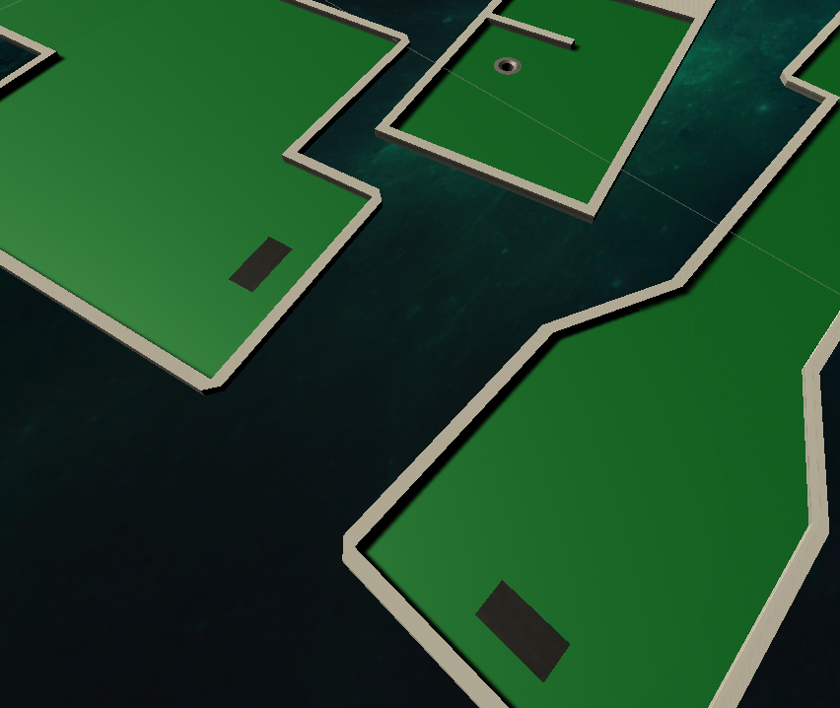
Growing Pains
How to get from one course to the next?
Tee off!
Level Manger Script

Slide 17
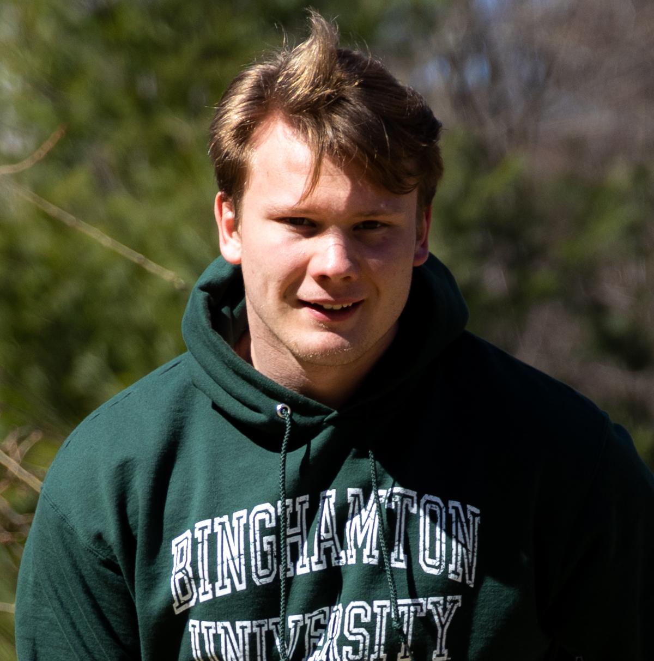

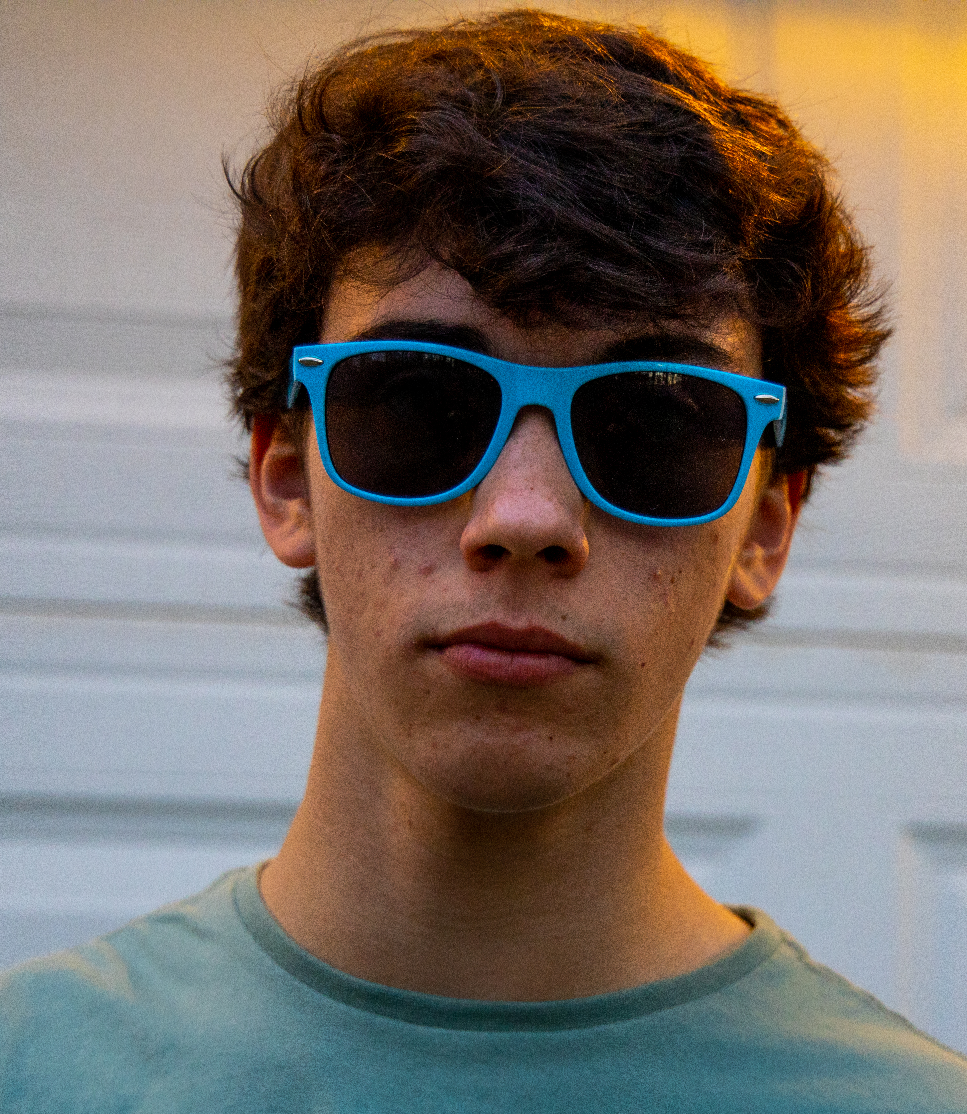
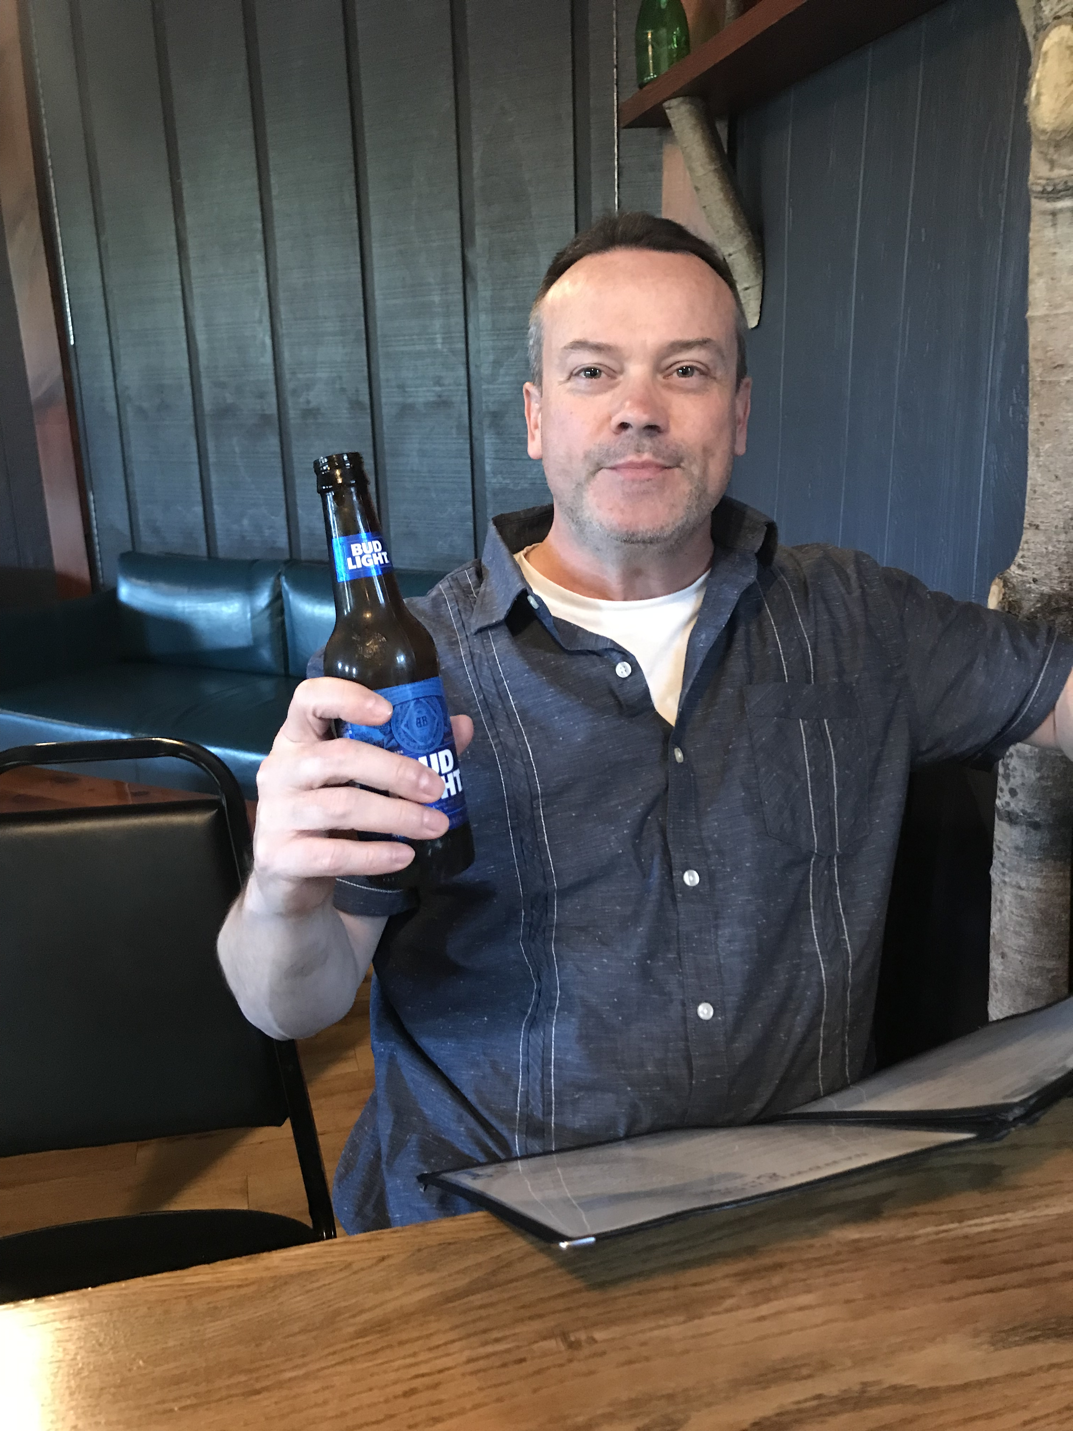
Beta Testing
Most useful step of the entire project
https://www.kissclipart.com/computer-clipart-computer-clip-art-jegkts/

Slide 18
Beta Testing
3 Beta Testing rounds
Round 1 – Trying to figure out controls and what they think
Round 2 – Stress testing. Break the game.
Round 3 – Back to first tester and a third set of eyes.

Slide 19

Beta Testing: things learned
Mass of the ball needed to increase
Allows to get in the whole easier
Allows for close range shots
Ball out of bounds
Power meter
Could change but user adapts
End of game
Restart option
Display score
https://4570book.info/amazing-cliparts/bad-golfer-clipart-images.htm

Slide 20

VRTK
“VR mode”
Enables HMD camera
Allows you to pick up club and use it to move the ball
Stroke count increases with each tap of the club
https://skarredghost.com/2018/04/30/vrtk-announces-version-4-thanks-to-an-oculus-grant/

Slide 21
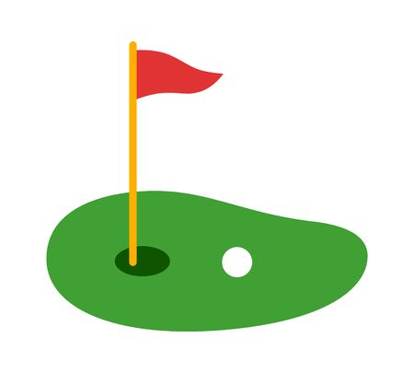
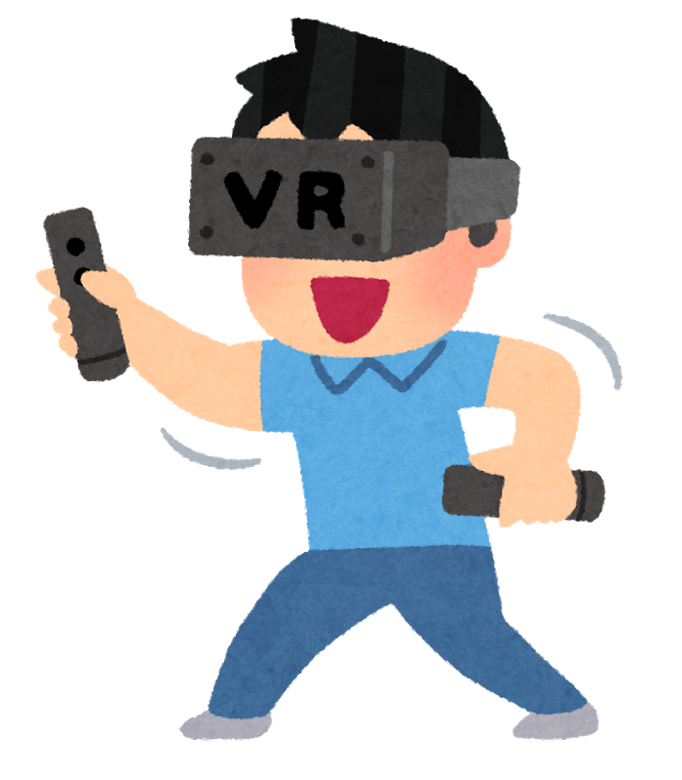
Future Work
Connect to head mounted display!
Possibly rescale for VR?
Add more visuals such as a windmill or flowing water
https://www.clipart.email/clipart/mini-golf-clipart-images-244101.html
https://www.hiclipart.com/free-transparent-background-png-clipart-pnlpv

Slide 22
Let’s Play Mini Golf !!!
https://github.com/jmgregor/IMGS-624

Slide 23
Questions?

